Slide 1
B.Sc. (Honours) Electronics With Computer Technology
Specialization in AI, Machine Learning, Robotics & Automation
Shape the future with cutting-edge technology and hands-on expertise in artificial intelligence, robotics, and intelligent systems.

Slide 2
Why Choose This Program?
Future-Ready Skills
Master AI, machine learning, and robotics technologies that are transforming industries worldwide.
Practical Experience
Engage in hands-on workshops, projects, and extension activities that bridge theory and real-world application.
Career Opportunities
Access diverse career paths in tech, manufacturing, healthcare, and emerging technology sectors

Slide 3

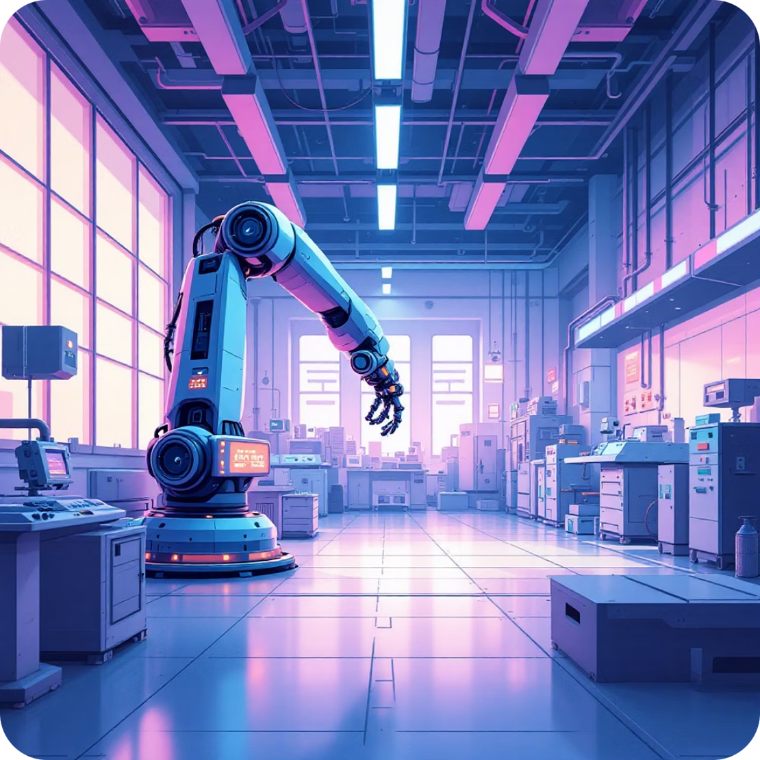
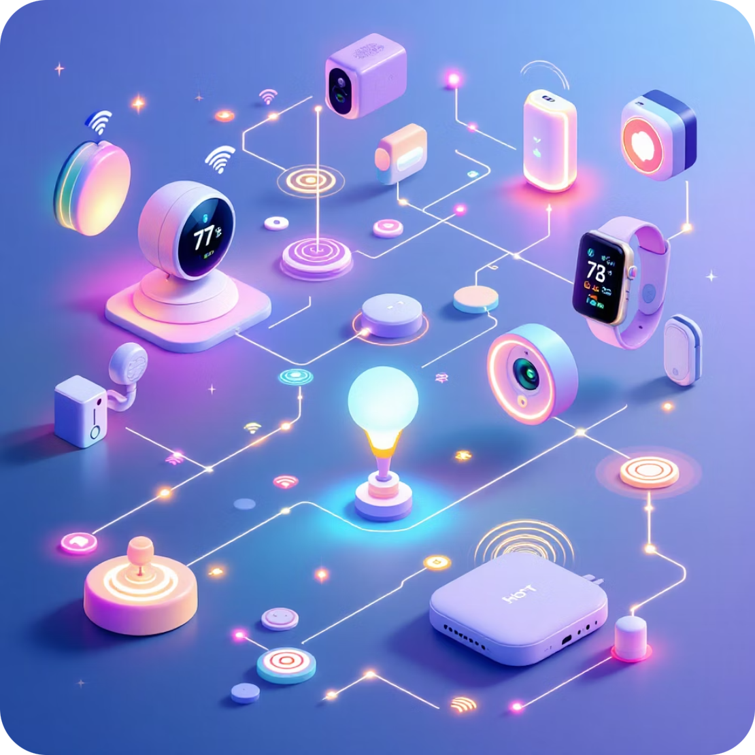
Core Specialization Areas
Artificial Intelligence
Robotics & Automation
Internet of Things
Explore machine learning algorithms, neural networks, and AI system development for intelligent decision-making.
Design and program robotic systems that automate complex tasks and enhance operational efficiency.
Connect devices and sensors to create smart systems that communicate and share data seamlessly.

Slide 4
Program Structure & Curriculum
Foundation Courses
Electronics fundamentals, computer architecture, programming languages, and digital systems design.
Core Specialization
Advanced topics in AI, machine learning algorithms, robotics programming, and automation systems
Hands-On Projects

Slide 5
Industry Integration
Workshops, seminars, and certificate courses aligned with industry requirements and emerging trends.
Hands-On Projects
Real-world projects integrating multiple technologies, from IoT applications to AI-powered robotics.

Slide 6
Certificate Courses Offered
Green Computing
Learn energy-efficient computing practices, sustainable technology solutions, and environmentally responsible system design.
Computer Hardware & Maintenance
Master hardware troubleshooting, system assembly, network configuration, and advanced maintenance techniques for modern computing systems.

Slide 7
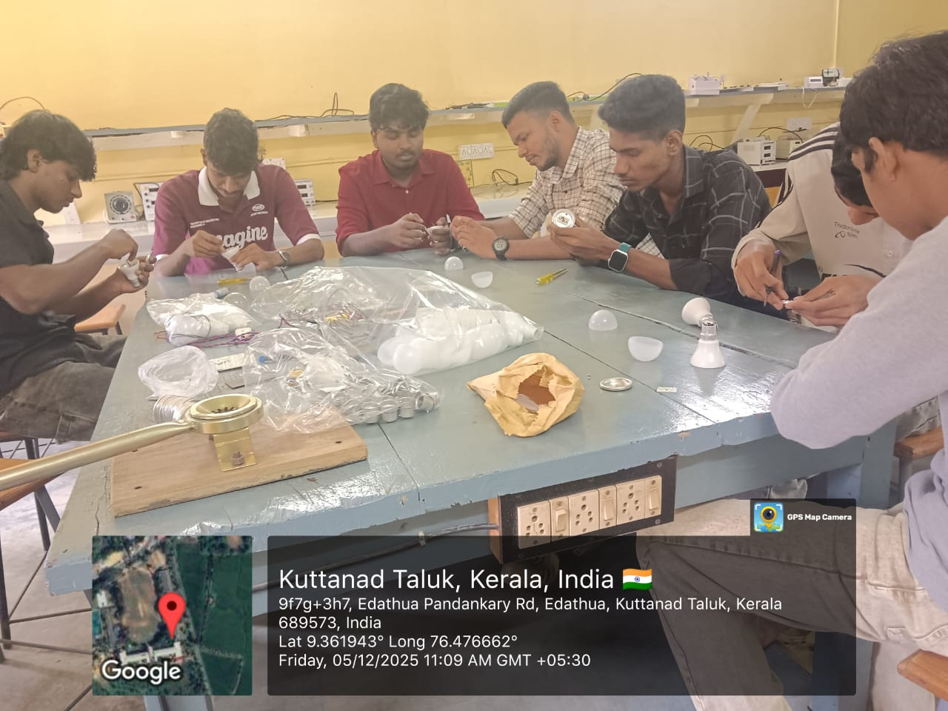
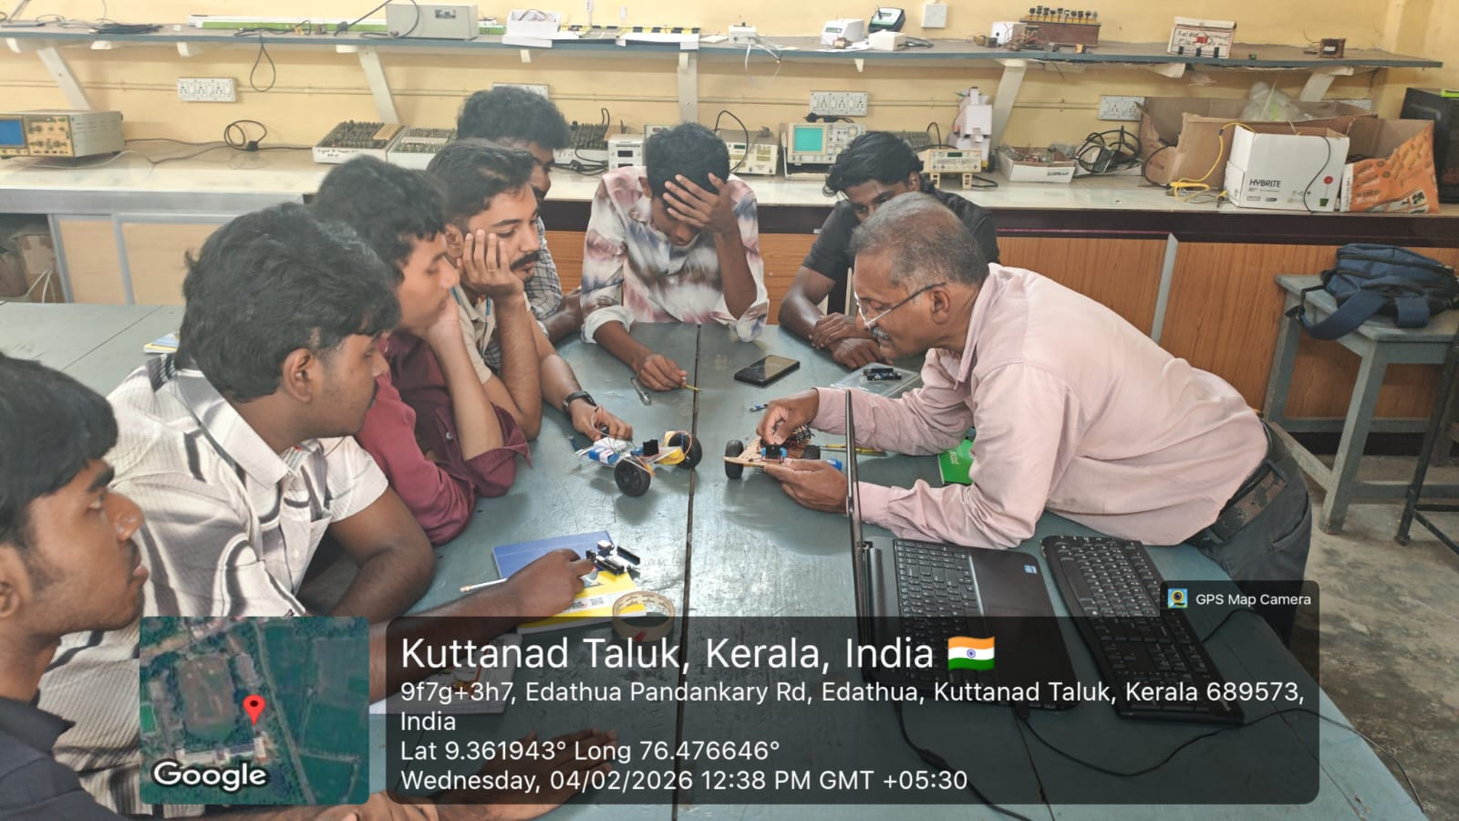
Hands-on Learning Experiences
LED Bulb Making Workshop
Design and assemble LED lighting systems while learning about energy efficiency and practical electronics applications.
Workshop on Coding & Robotics
Develop programming skills specifically for robotic systems and automation through guided, project-based learning.

Slide 8
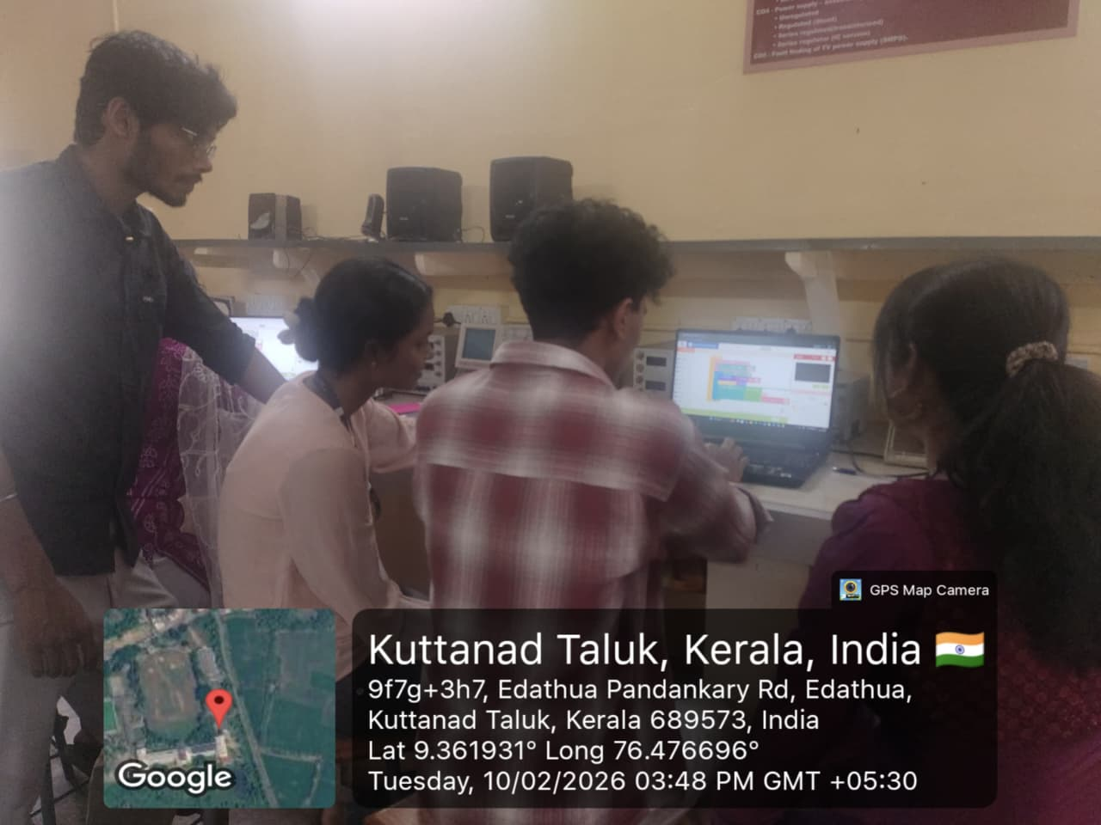
Workshop on IoT Basics
Build connected devices and sensor networks, understanding the fundamentals of the Internet of Things ecosystem.

Slide 9
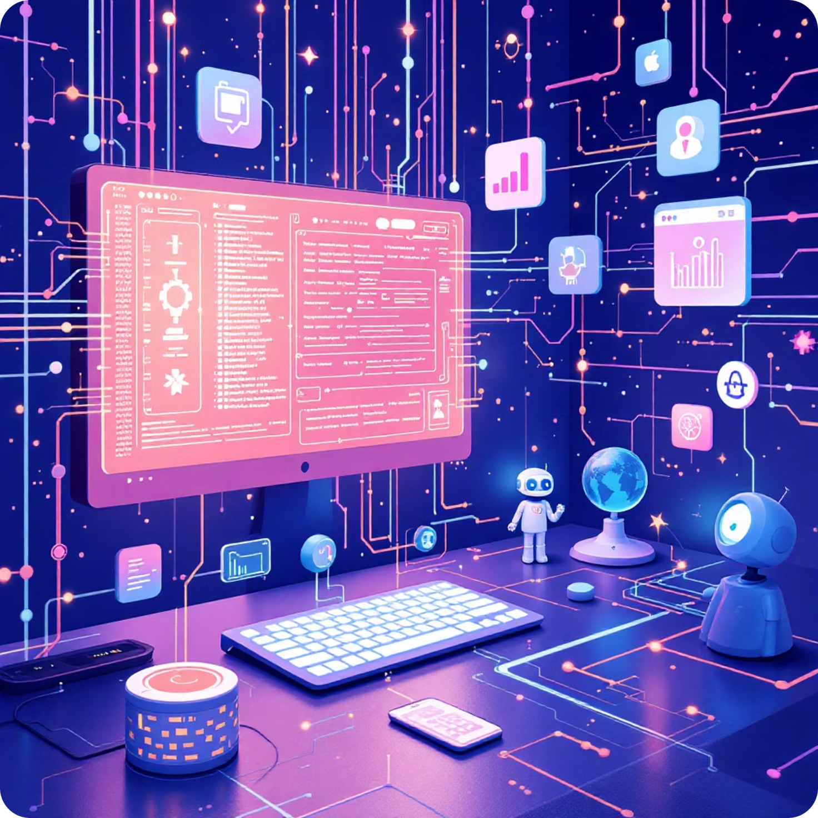
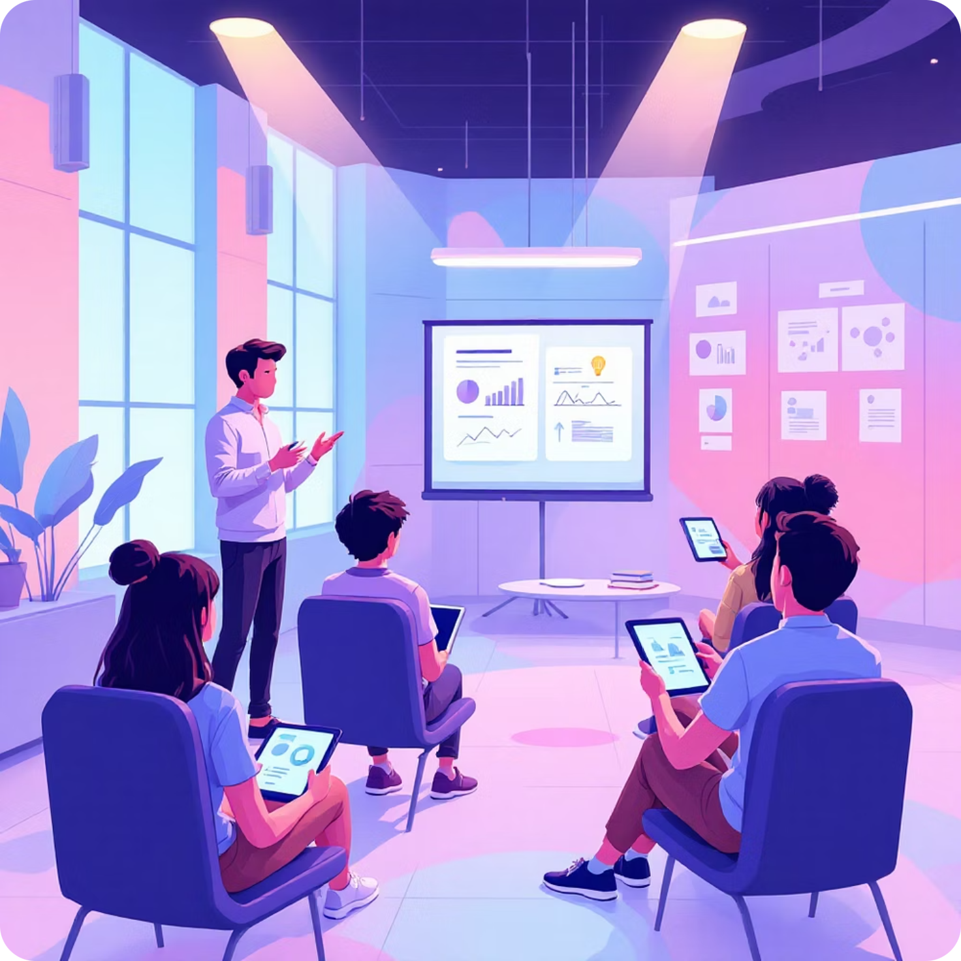
Advanced Technical Workshops
AI Tools & Smart System Development
Master industry-standard AI development tools and frameworks for creating intelligent, adaptive systems.
Skill Development Seminar
Enhance learning methodologies and productivity techniques specifically for technology education.

Slide 10
Extension Activities & Special Programs
LED Bulb Making Extension
Community-focused projects where students apply technical skills to create practical solutions for local communities
Workshop on Coding & Robotics
Extended sessions focusing on advanced programming languages and robotic platform integration for complex applications.
Workshop on IoT Basics
Introduction to sensor networks, data collection, and cloud integration for creating connected smart environments.

Slide 11
Career Pathways & Opportunities
Robotics Engineer
Design and program robotic systems for manufacturing, healthcare, and service industries.
AI/Machine Learning Specialist
Develop intelligent algorithms and predictive models for data-driven decision-making
IoT Solutions Developer
Create connected ecosystems integrating hardware, software, and cloud platforms.

Slide 12
Ready To Start Your Journey?
Why This Program?
Our curriculum combines electronics fundamentals with computer technology, focusing on AI, robotics, and automation
Practical Skills
Certificate courses in green computing and hardware maintenance, plus hands-on workshops in LED technology and IoT, Artificial intelligence & ML, also in Robotics
Future-Ready
Prepare for careers in robotics, AI development, IoT systems, and automation engineering.

Slide 13








Enroll today and begin your journey in Electronics with Computer Technology, specializing in AI, Machine Learning, Robotics & Automation. Our program includes certificate courses in Green Computing and Computer Hardware & Maintenance, plus hands-on workshops in LED Bulb Making, IoT, and AI tools development.

